Slide 3
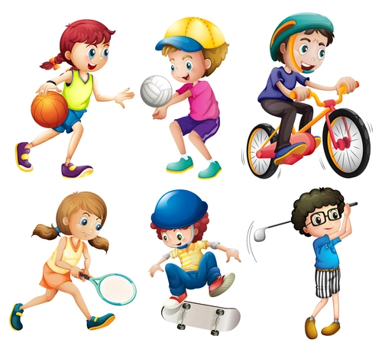
UNIT 6: SPORTS
LESSON 3: LANGUAGE FOCUS - page 75.

Slide 4
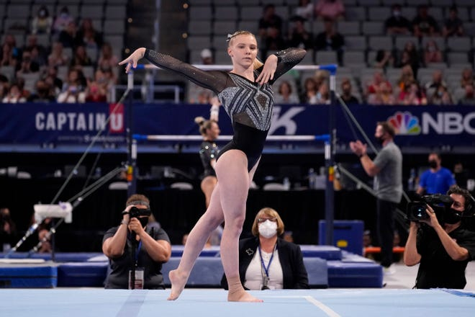
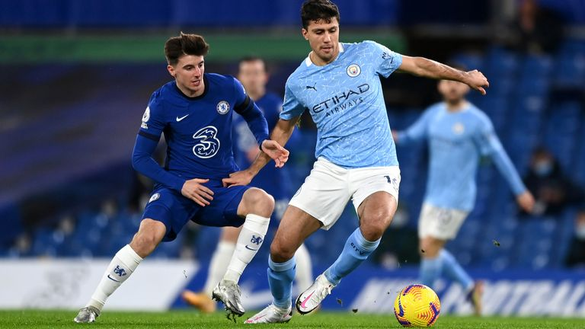
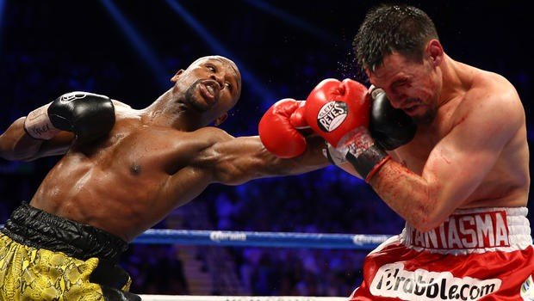
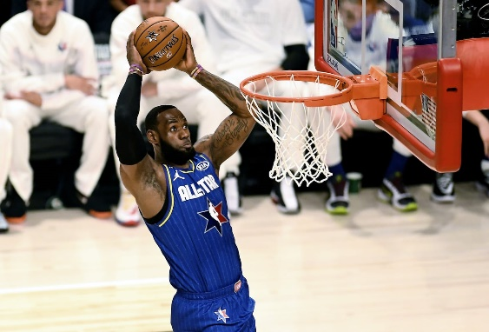
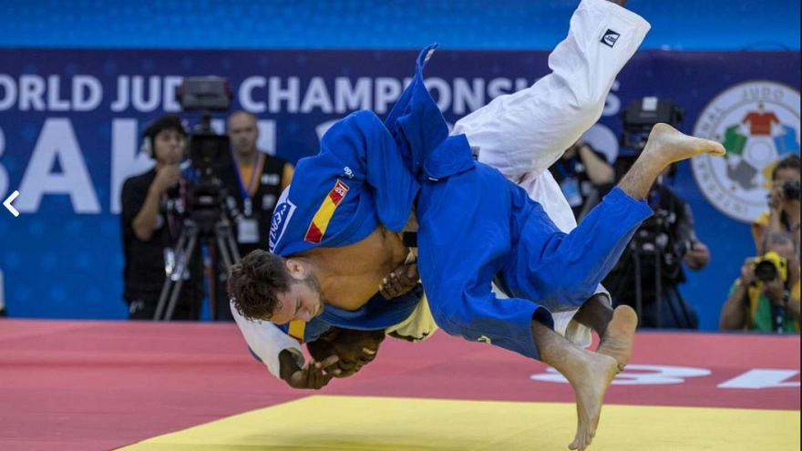
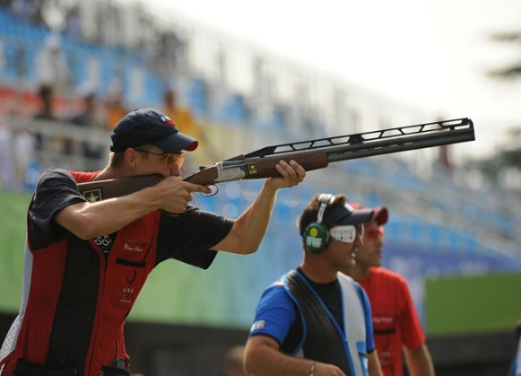
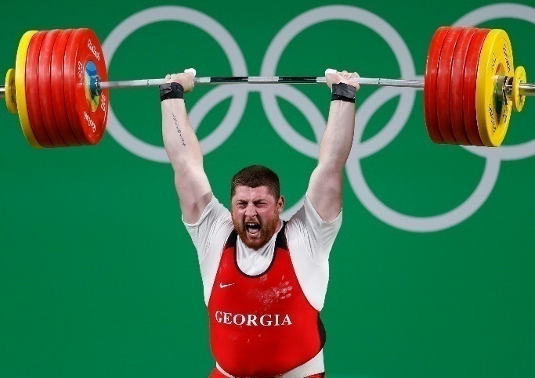
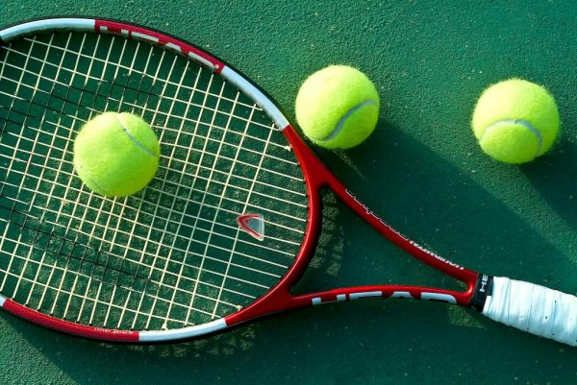
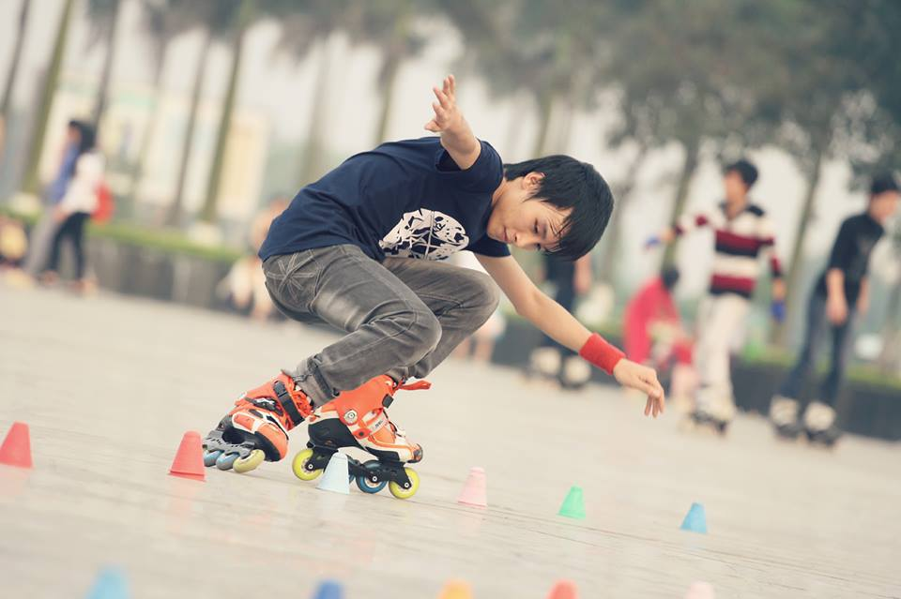
OPEN, SESAME
3
1
Football
Gymnastics
2
Boxing
4
6
Basketball
Judo
5
Shooting
7
8
9
Tennis
Weightlifting
Rollerblading: trượt patin

Slide 5
OPEN, SESAME
Gymnastics
Boxing
Football
What sports are played in the Olympics?
Shooting
Basketball
Judo
Weightlifting
Tennis

Slide 6
OPEN, SESAME
What sports are not played in the Olympics?
Rollerblading

Slide 7
EXERCISE 1: Complete the examples from the text. Then choose the correct words in the Rules - page 75.
There were
There wasn't

Slide 8
GRAMMAR POINTS
THERE WAS / THERE WASN'T...
(+)There was + a /an + singular Noun
Eg: There was a fire in the town center.
(-) There wasn't + a/an + singular Noun
Eg: There wasn't a good film on TV last night.
THERE WERE/ THERE WEREN'T...
(+) There were + some + plural Noun
Eg: There were some people here.
(-) There weren't + any + plural Noun
Eg: There weren't any books there.

Slide 9
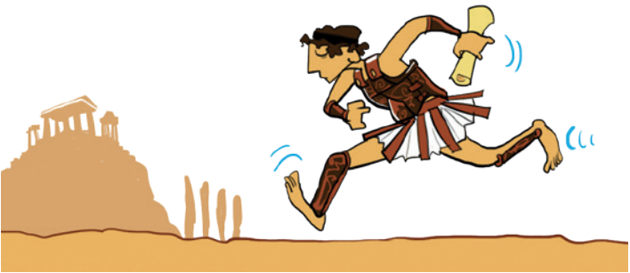
EXERCISE 2: Work in pairs. Complete the text with affirmative and negative form - page 75.
there was
there were
There was
there wasn't
there weren't
There weren't

Slide 10
EXERCISE 3: Complete the text with affirmative and negative forms of There was and there were. Use Many/any or a/an - page 75.
2,500 years ago …
…..............................rich footballers.
…..............................chariot races.
….....................country called Persia.
….........................sport called skateboarding.
…..............................messengers.
…..............................iPads.

Slide 11
EXERCISE 3: Complete the text with affirmative and negative forms of There was and there were. Use Many/any or a/an - page 75.
2,500 years ago …
…..............................rich footballers.
…..............................chariot races.
….....................country called Persia.
….........................sport called skateboarding.
…..............................messengers.
…..............................iPads.
There weren't any
There were many
There was a
There wasn't a
There were many
There weren't any

Slide 12
EXERCISE 4: USE IT! .Work in pairs. Compare your sentences in Ex 3.

Slide 13
EXERCISE 5: Complete the sentences about Olympics timeline text. Then complete the Rule -page 75.
were
was
was
wasn't
weren't
is and are
wasn't
weren't

Slide 14
GRAMMAR POINTS
The simple past tense of the verb to be:
The affirmative form:
Eg:
I was in London in 1999.
Pam was in London in 1999, too.
We were together.
The negative form:
Eg:
I wasn't in Paris in 1999.
Pam wasn't in Paris in 1999.
We weren't in Paris.
I, he, she, it | was.
you, we, they | were.
I, he, she, it | was not.
 | wasn't.
You, we, they | were not.
 | weren't.

Slide 15
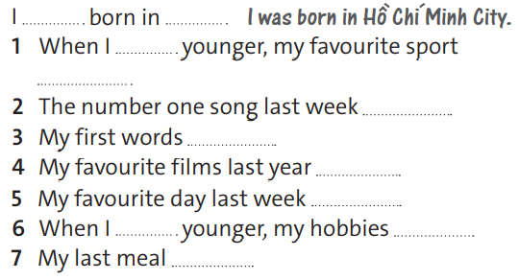
EXERCISE 6: Complete the sentences with was and were and your own ideas.
was
was
were
were
was
was
were
was

Slide 16
EXERCISE 7: Work in groups. Compare your sentences in EX 6

Slide 17
Think of more differences life 100 years ago and now. Use there was/wasn't, there were/weren't.
Eg:
- There weren't a lot of cinemas 100 years ago.
- There weren't supermarkets 100 years ago.
......

Slide 18
- Learn by heart all structures.
- Workbook: Exercises page 43.

Slide 19
Thank you!
CTCP ĐẦU TƯ VÀ PHÁT TRIỂN GIÁO DỤC PHƯƠNG NAM

